Slide 1
Analysis of jobs affected due to Automation
Instructor: Rong Liu Course: BIA-660-C

Slide 2
Content
Introduction
Web Scraping
Data Preprocessing
Exploratory Data Analysis

Slide 3
Introduction
Around 7 million people lost their daily wages amid 2004-09.
Real reason is automation and lack of skills with the changing times.
Hence, we are set to create an analysis which helps the workforce to keep up with the trends around them and develop the skills which cannot be easily replaced by automation.
The analysis will recommend skills to laborers to level up with the changing industry standards.
All skill sets are to be compared and checked for their relevance in the real world for now and for next few years too.

Slide 4

Web Scraping
CareerBuilder is an online employment website for job opportunities and advice. It is one of the leading online employment services in North America and Europe.
It uses data science to evolve the human capital management space, with options that assist employers find, employ and manage fantastic people.
We scraped 2500 different job positions - job title, location, skills required, date of posting, description and pay per hour.

Slide 5

Career Builder Website
Attributes of jobs for scraping are :
Position offered
Description
Description
Company name
Location and pay

Slide 6
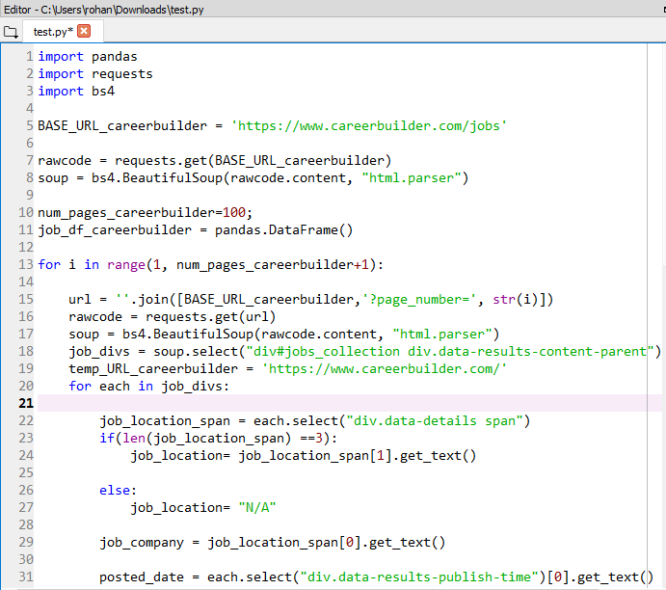
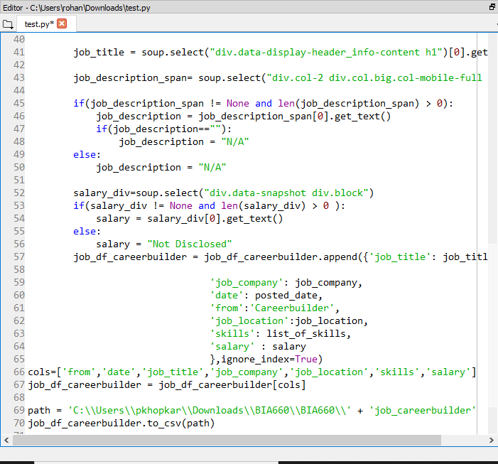
Code Snippet for scrapping Jobs
Scrapped first 100 pages of Careerbuilder having 25 jobs each page to get details 2500 Jobs and store the data into file

Slide 7
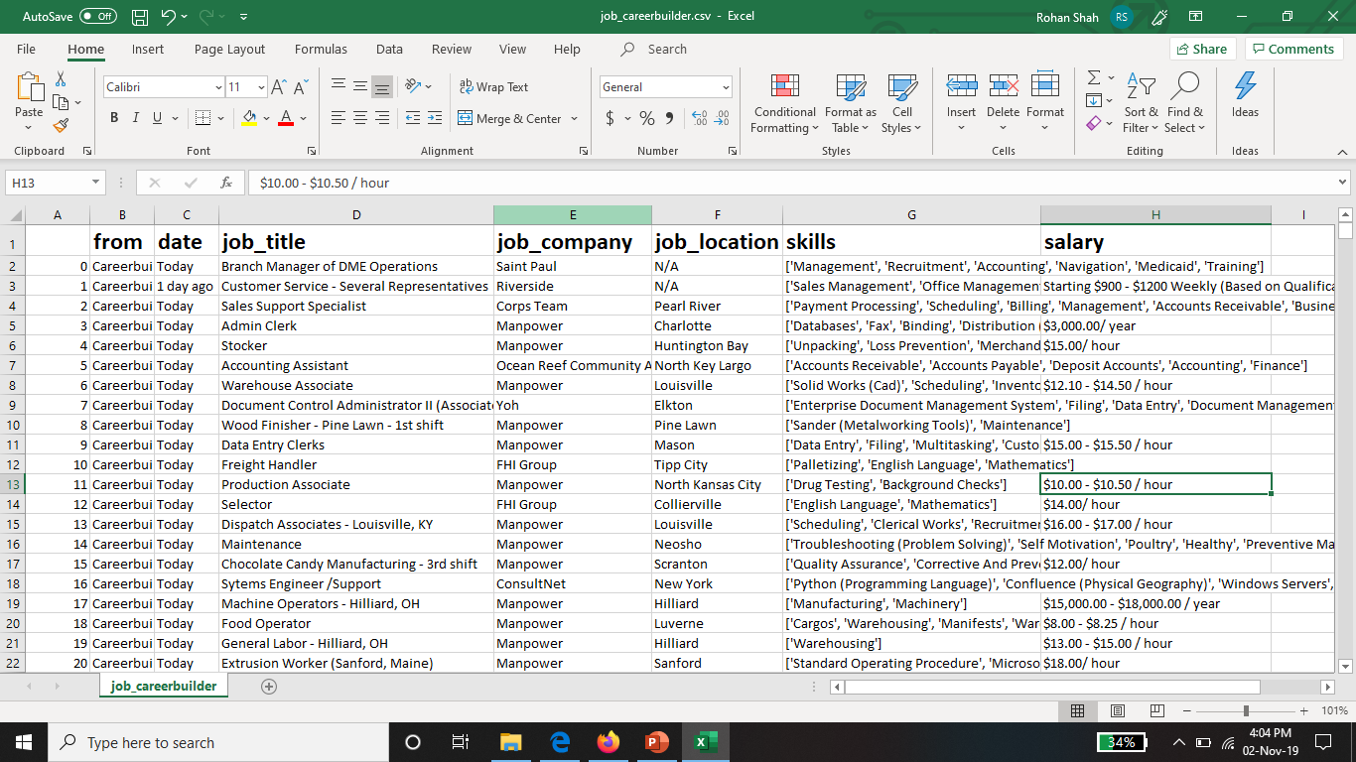
Scrapped data from Careerbuilder

Slide 8
Data Cleaning and Processing
Cleaned the scrapped data as follows :
Changed date format to MM/DD/YYYY
Job posted currently does not show current date but rather shows posting time in the format as “Today” or “1 day ago” etc. We replaced the current date posting format to actual date like mm/dd/yyyy.
Removed jobs having missing values of Job Location.
Analyzed for probable outliers and removed them from existing data
Skills were collected in the form of list for each Job, so created a separate entry of each skill so that further analysis on skill can be perform

Slide 9
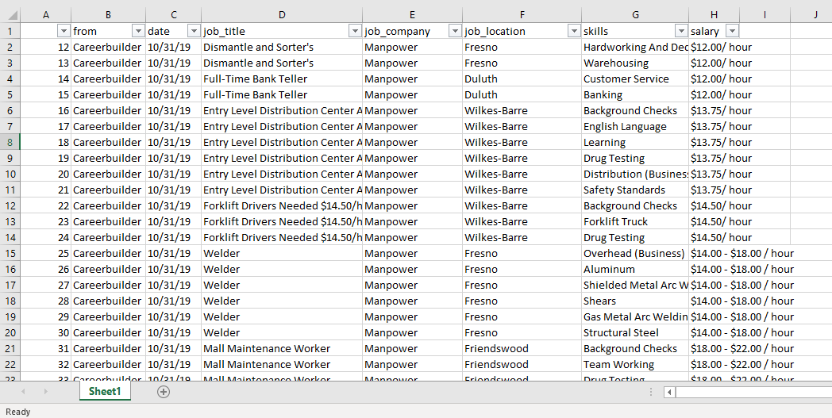
Cleaned and processed data

Slide 10
Exploratory data analysis
From the data, it can be observed that there are no labels available. Hence, we performed clustering on the existing dataset which is part of Unsupervised learning
Clustering is done to group similar skills into same clusters.
K-means algorithm is used to perform clustering of skills. It helped summarization, compression and efficiently finding nearest neighbors.

Slide 11
K – means Algorithm
Steps for K-means are as follows:
Cluster skillsets into K clusters
Select a point as initial centroid
Create a cluster by assigning each point to its nearest centroid by distance.
Most commonly occurring centroids are chosen.
The method used for calculating distance is Cosine similarity.
Cosine Similarity is highly used for calculating text similarity among documents.

Slide 12
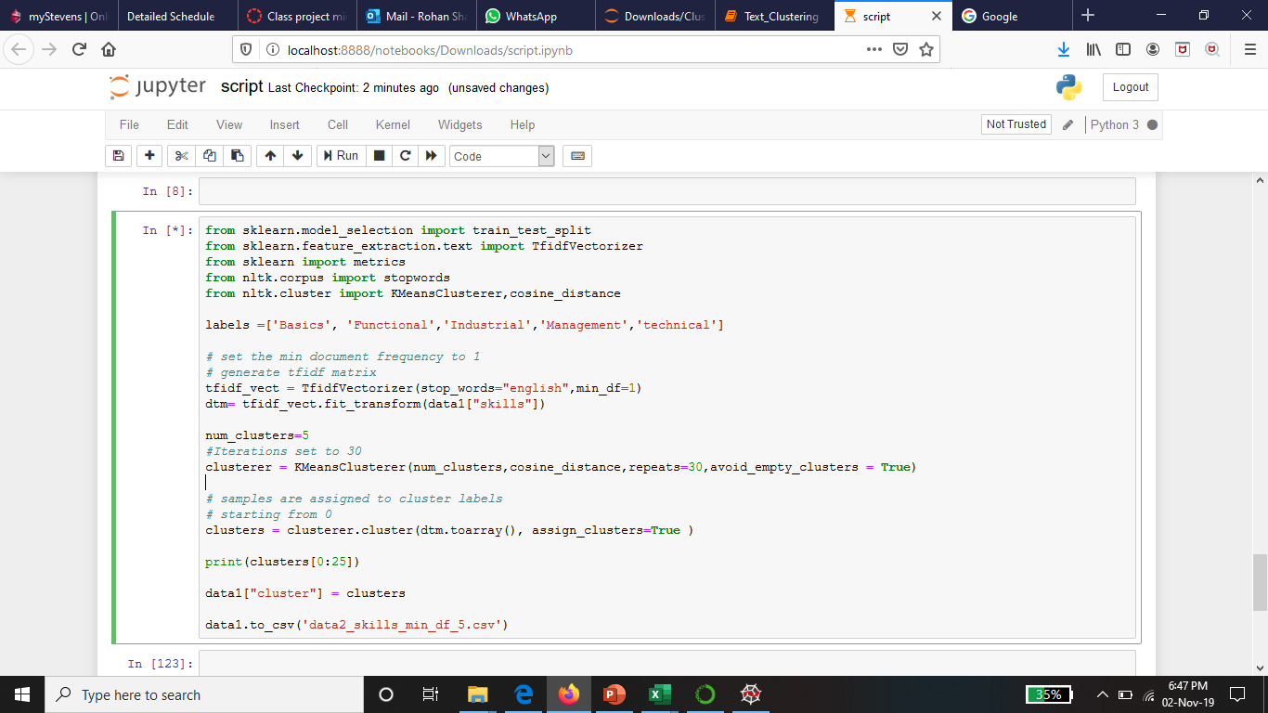
Code snippet for K-means of Skills

Slide 13
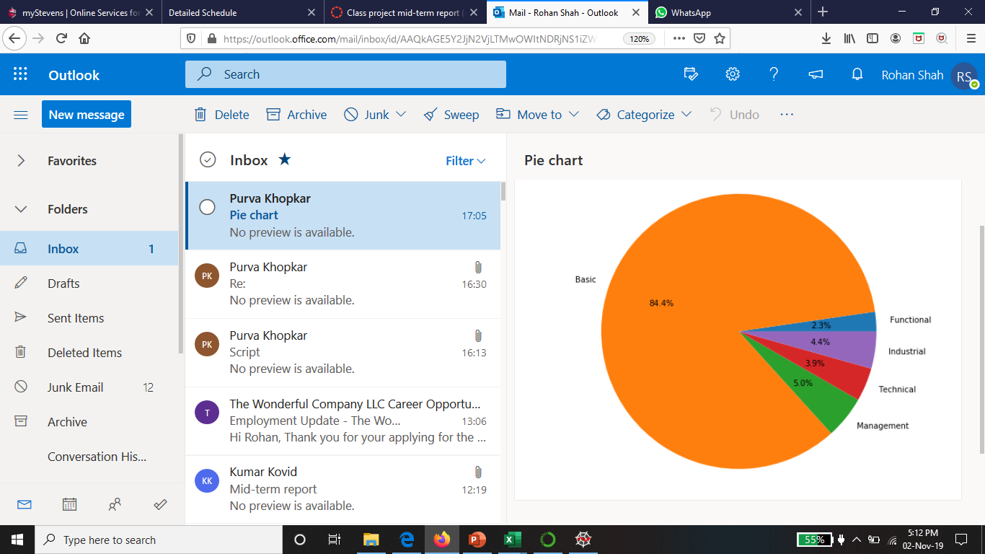
Analysis of Clusters
Using K-means algorithm 5 clusters were created.
Text clustering was performed on skills and there were 5 highly common categories – Basic, Functional, Industrial, Technical and Management skills
From the pie chart, it can be observed that category of skills – Basic is highest among all the categories
Fig1 : Pie chart showing all the categories of skills

Slide 14
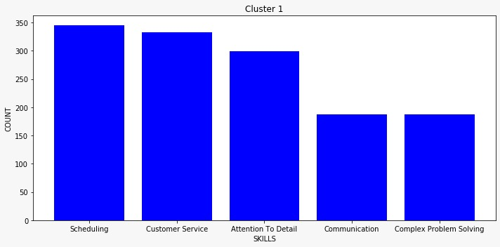
Top 5 skills in each cluster
We sort the clusters and arrange them with the count of skills in the cluster
This graph is generated for all clusters and their top skills
From bar pie chart, it can be observed that the top 5 skills in the first cluster is displayed
Cluster 1

Slide 15
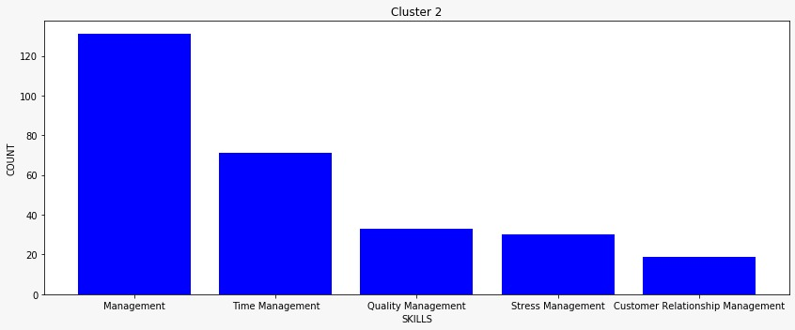
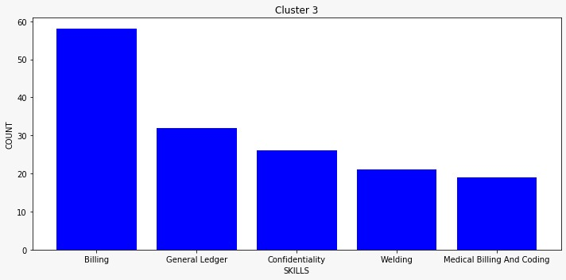
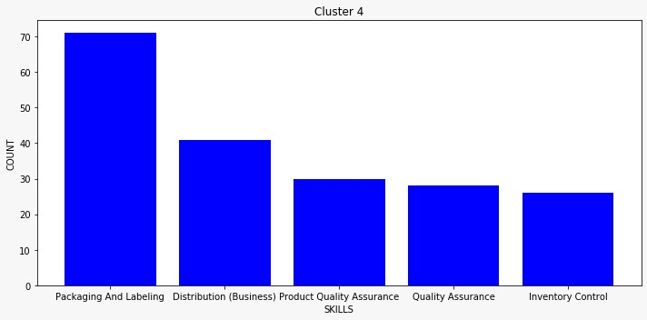
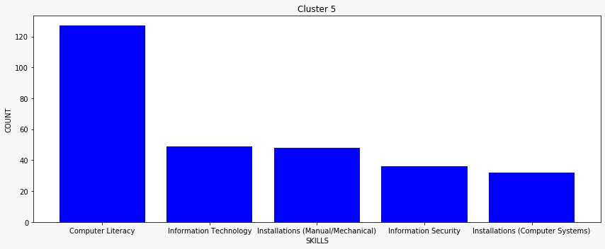
Top 5 skills in each cluster
Cluster 2
Cluster 3
Cluster 4
Cluster 5

Slide 16
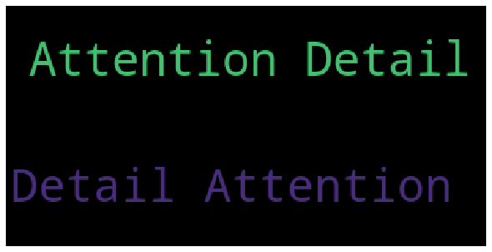
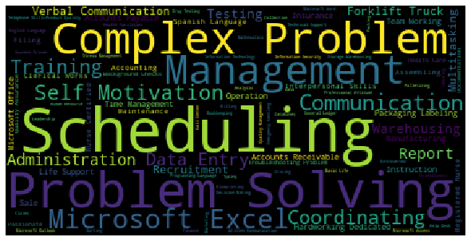
Clusterwise Wordcloud
Cluster 1
Cluster 2

Slide 17
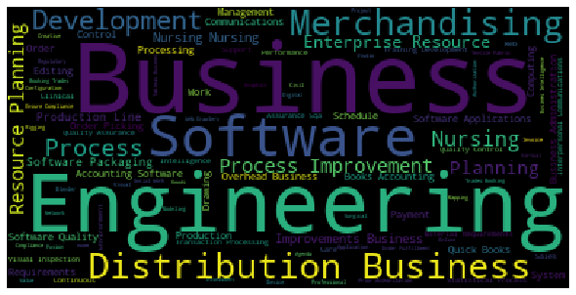
Clusterwise Wordcloud
Custer 1
Cluster 3
Cluster 4

Slide 18
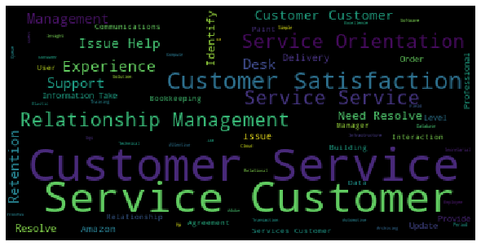
Clusterwise Wordcloud
Cluster 5

Slide 19
Steps completed
Steps | Group Members
Scrapping of Careerbuilder website to scrape data of 2500 Jobs | Purva and Bhagyashree
Data cleaning and preprocessing | Parth
Exploratory Data Analysis | All members
Clustering ( K means) | Purva and Bhagyashree
Report preparation | Rohan

Slide 20
Action plan
Testing of existing K-mean clustering using Test data to evaluate performance of the model
As per evaluation, fine tune the model for entire data set
We are planning to perform the clustering on Historical data of Jobs to get the good mix of skills
We are also planning to perform Topic modelling using Latent Dirichlet allocation to summarizing the skills
We will perform analysis of the clusters for Highly and less likely automatable skills

